Slide 1
Sahastransh Mandhana
Subject : Science Course : JEE Purpose: Admission in Narayana Andheri & request for additional Scholarship

Slide 2
Achievements
Won National Award (First Prize) in Moon Habitat Contest 2019 (Link: Annex - I)
Design and fabrication of nano-quadrotor Pluto (Drone) at IIT Bombay in Jun 2017 (Link: Annex - II)
Participated in Lunar Loo International Challenge held by NASA in 2020

Slide 3
Technical Activities and Participation
Developed search engine “Optimize”
Recognised at school level
Link : https://optimize.pythonanywhere.com
Developed Anticopying system “Vision”
Presented to Podar Powai Principal
Discussed with several professionals
Link : http://visioninco.pythonanywhere.com
Other
Secured 60% scholarship in TALLENTEX through out India in 2019
Participated in NSO in 2018 & 2011 (Link: Annexure – III)
Participated in IMO in 2011 (Link: Annexure – III)

Slide 4
Other Curriculum Activities
Playing various sports: Football, Cricket, Swimming, Athletics, Chess
Entitled as School Sports Captain for year 2019-20
Won three “Man of the Match” and “Player of the Tournament” award for IFS in SSE champion league 17-18 (football tournament) – team won the “Gold Cup”.
Represented Podar Powai for Football and Cricket in MSSA & DSO
Won various Medals in Football & Athletics
First in Relay race in 2018
Second in 100 mtrs running race in year 2018
(Link for all: Annexure - IV)

Slide 5
My Target
Clearing JEE and taking admission in IIT

Slide 6
Annexures

Slide 7
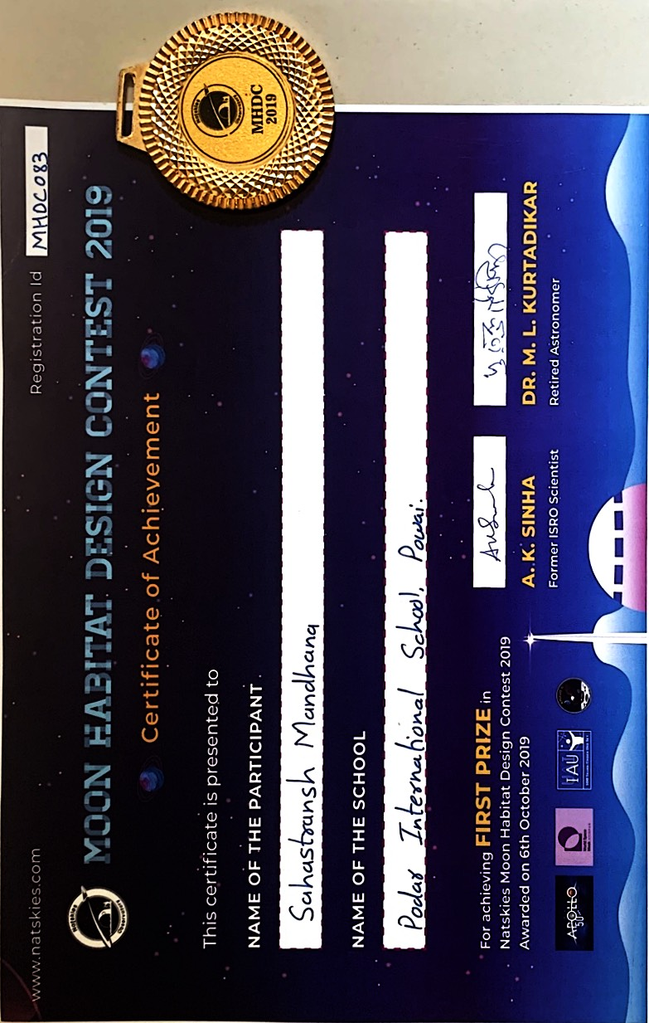
Annexure - I
Back to Achievement Slide

Slide 8
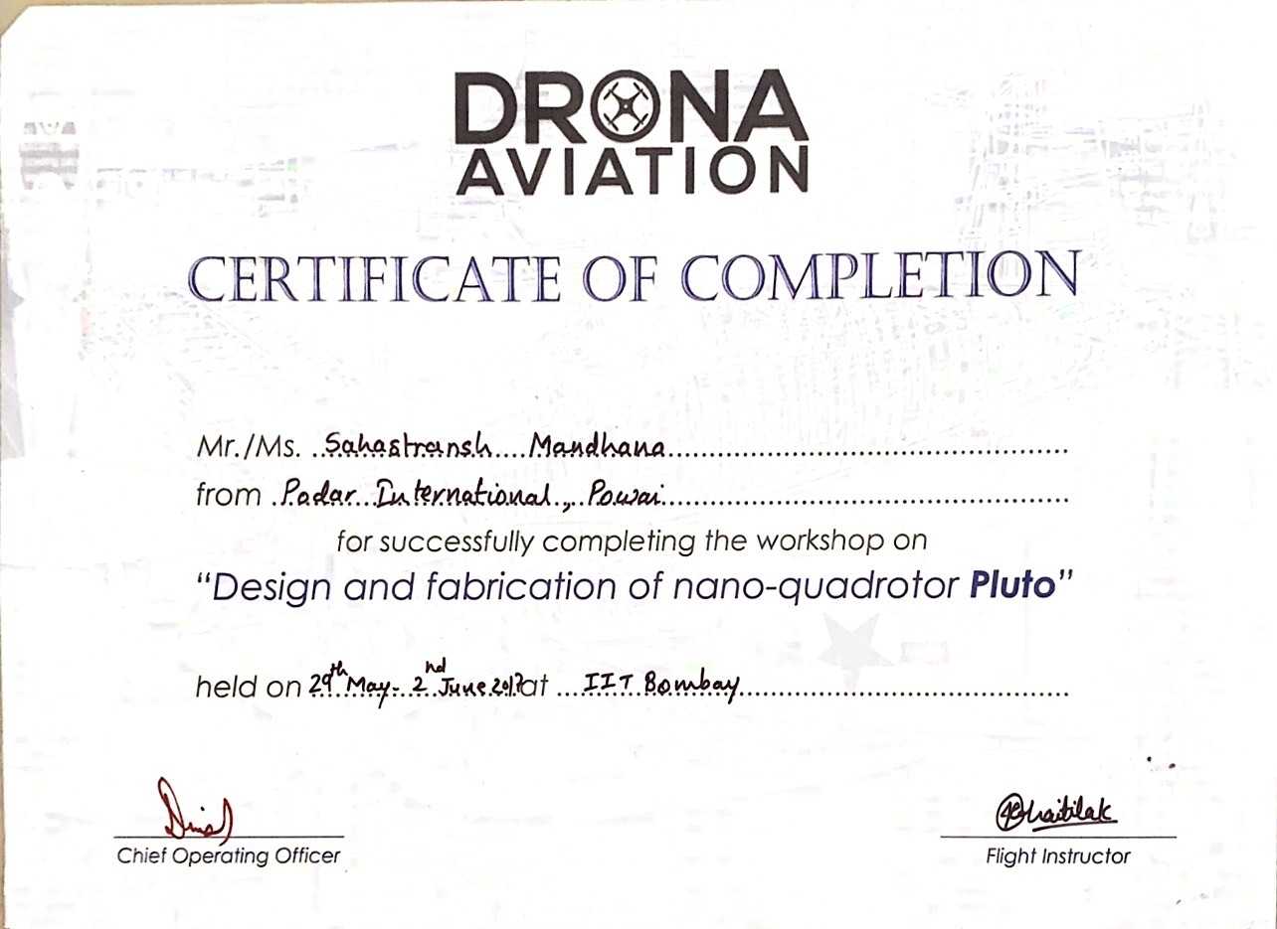
Annexure - II
Back to Achievement Slide

Slide 9
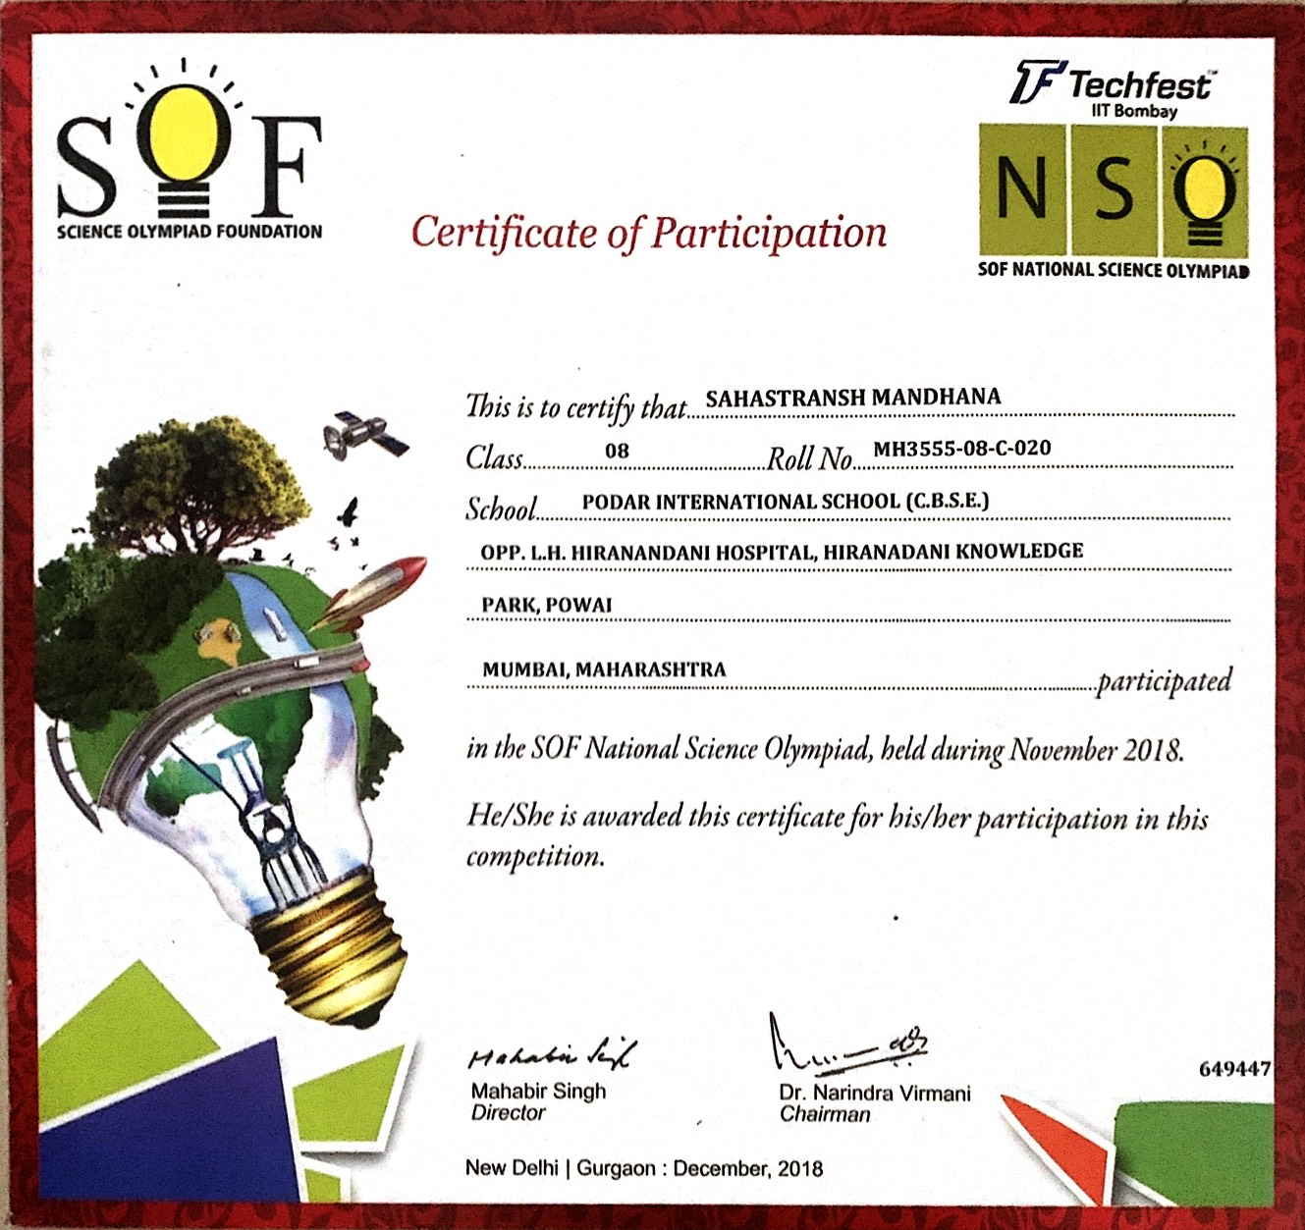
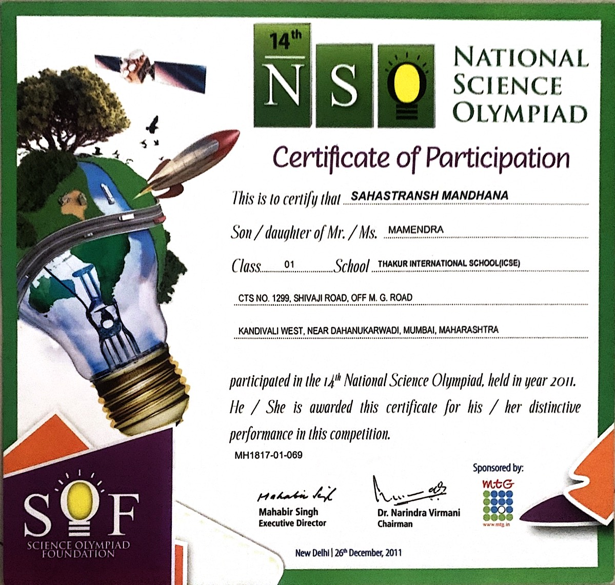
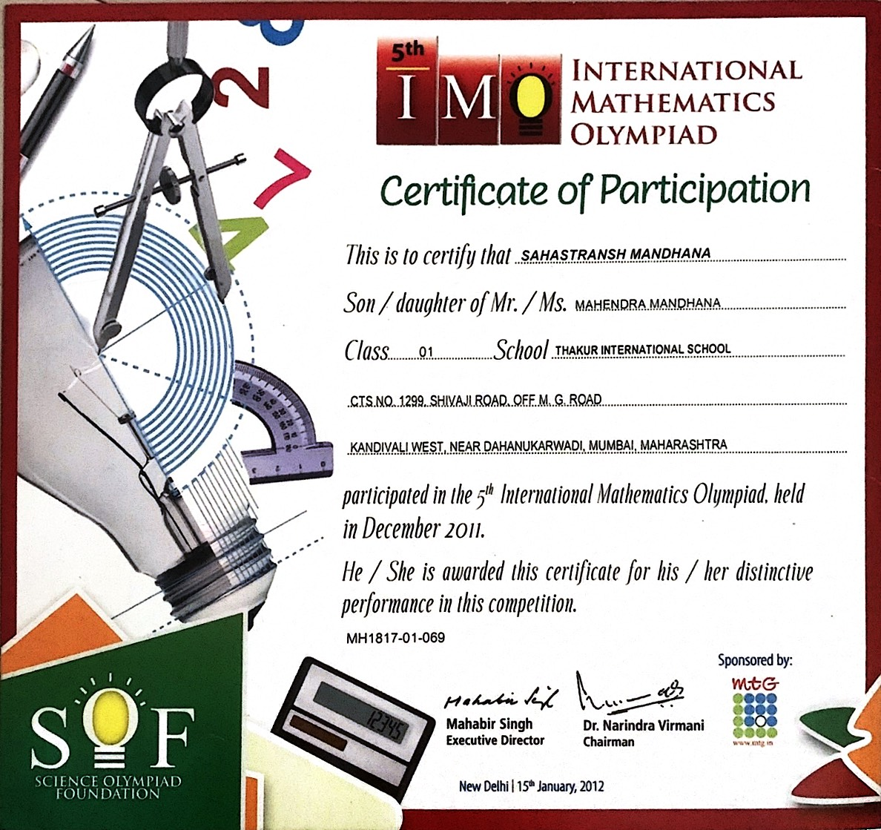
Annexure - III
Back to Technical Activities and Participation Slide

Slide 10
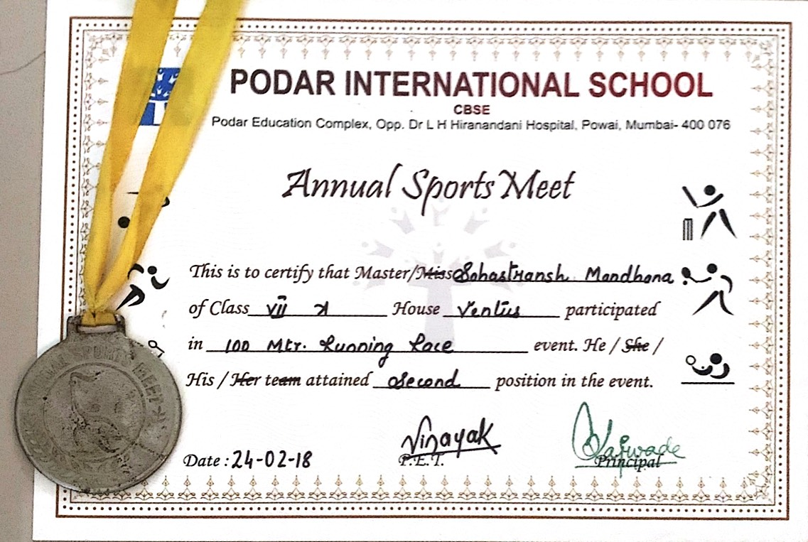
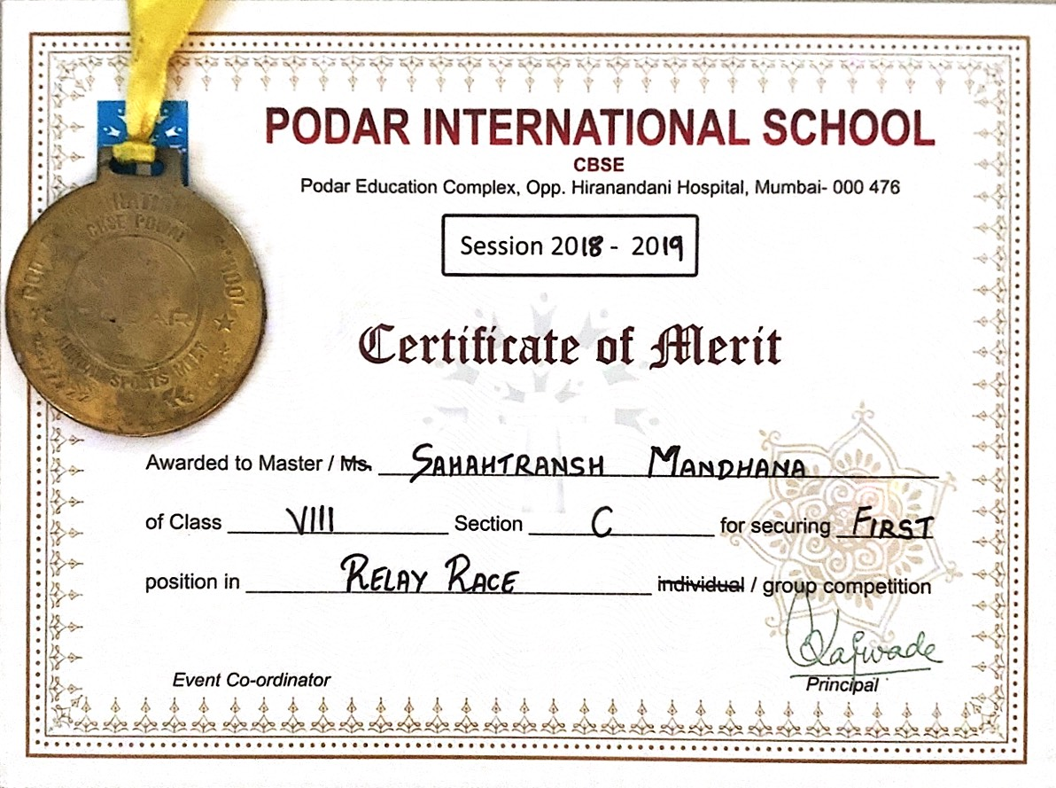
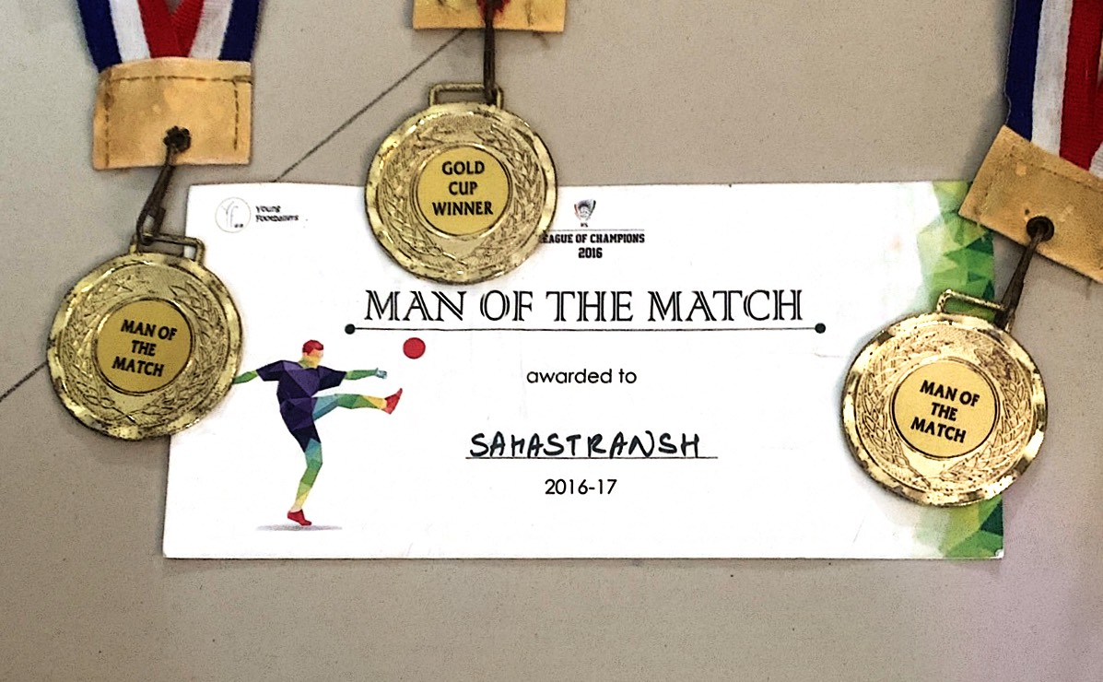

Annexure - IV
Back to Other Curriculum Activities Slide

Slide 11
Thank You

